Slide 1
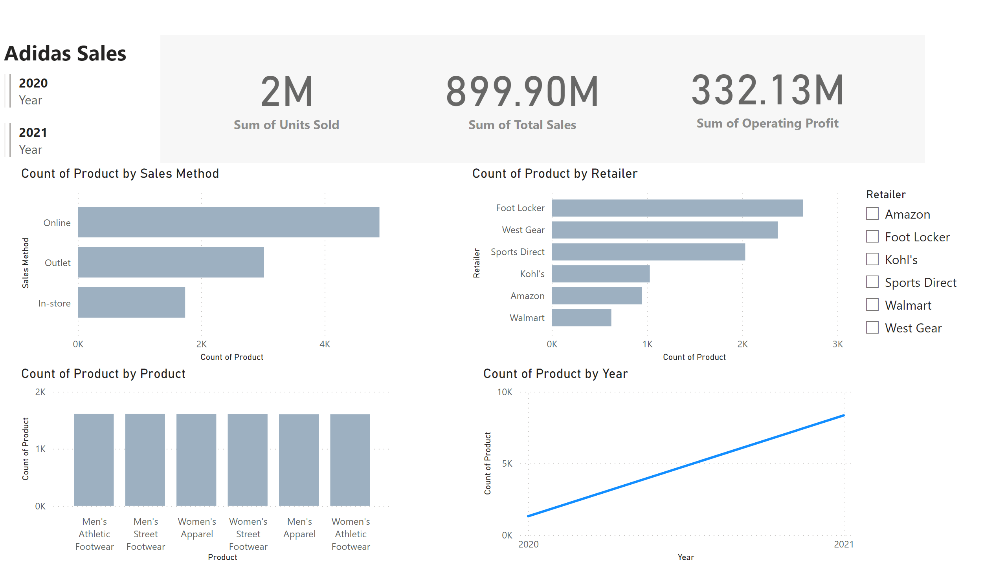
Sales
Notes:
textbox
No alt text provided
multiRowCard
No alt text provided
card
No alt text provided
card
No alt text provided
card
No alt text provided
shape
No alt text provided
clusteredBarChart
No alt text provided
clusteredBarChart
No alt text provided
columnChart
No alt text provided
lineChart
No alt text provided
slicer
No alt text provided

